Slide 1
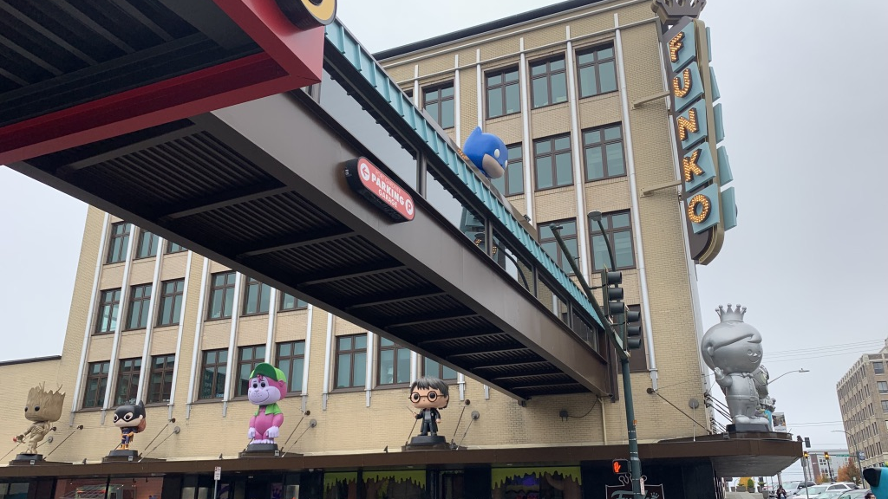
Funko POP! Price Predictor
Chuck Cao

Slide 2
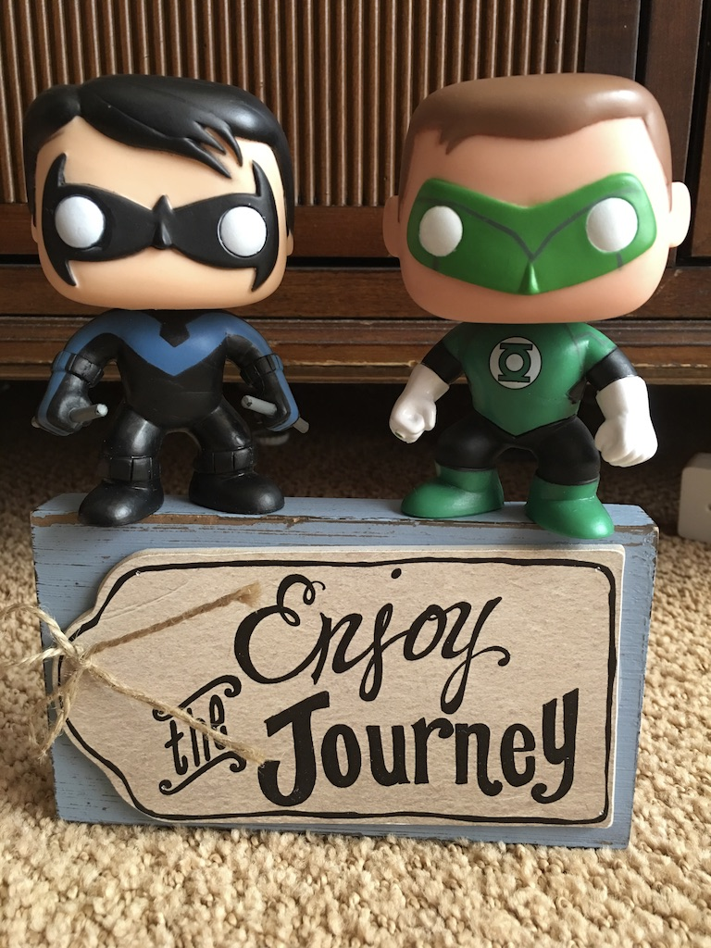
Agenda
Background
Purpose
Data Source
Assumptions
Final Linear Model
Further Work

Slide 3
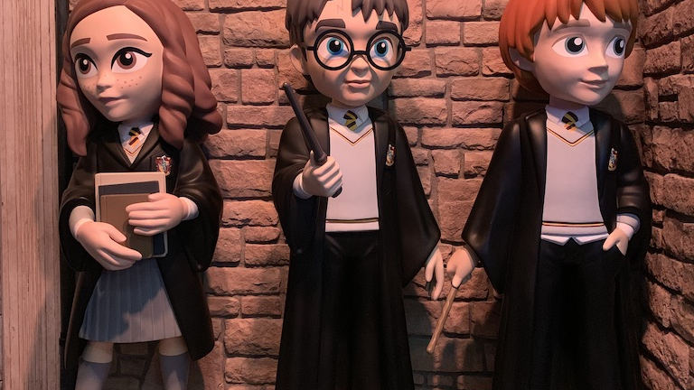
Background
“Funko is built on the principle that everyone is a fan of something…”

Slide 4

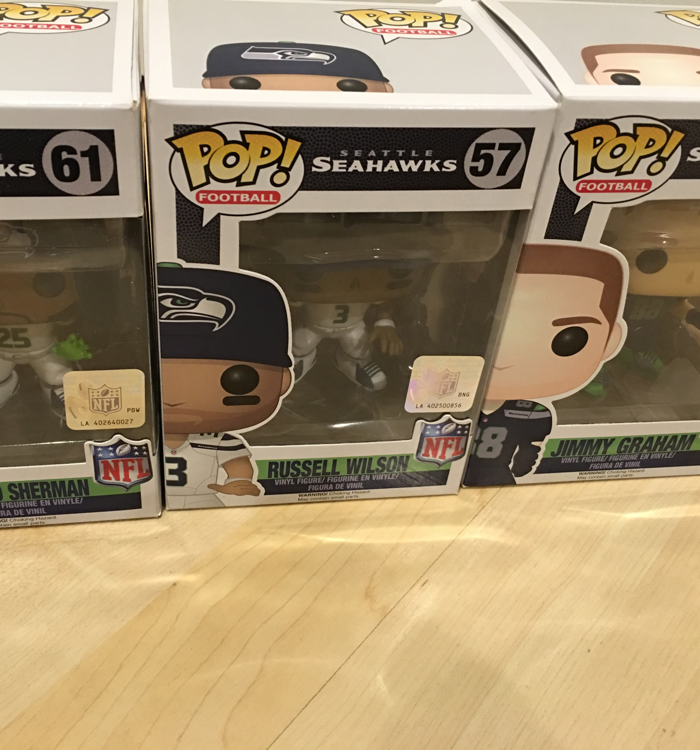
Purpose
Discerning collectors
Storage space
Budget
What to sell?

Slide 5
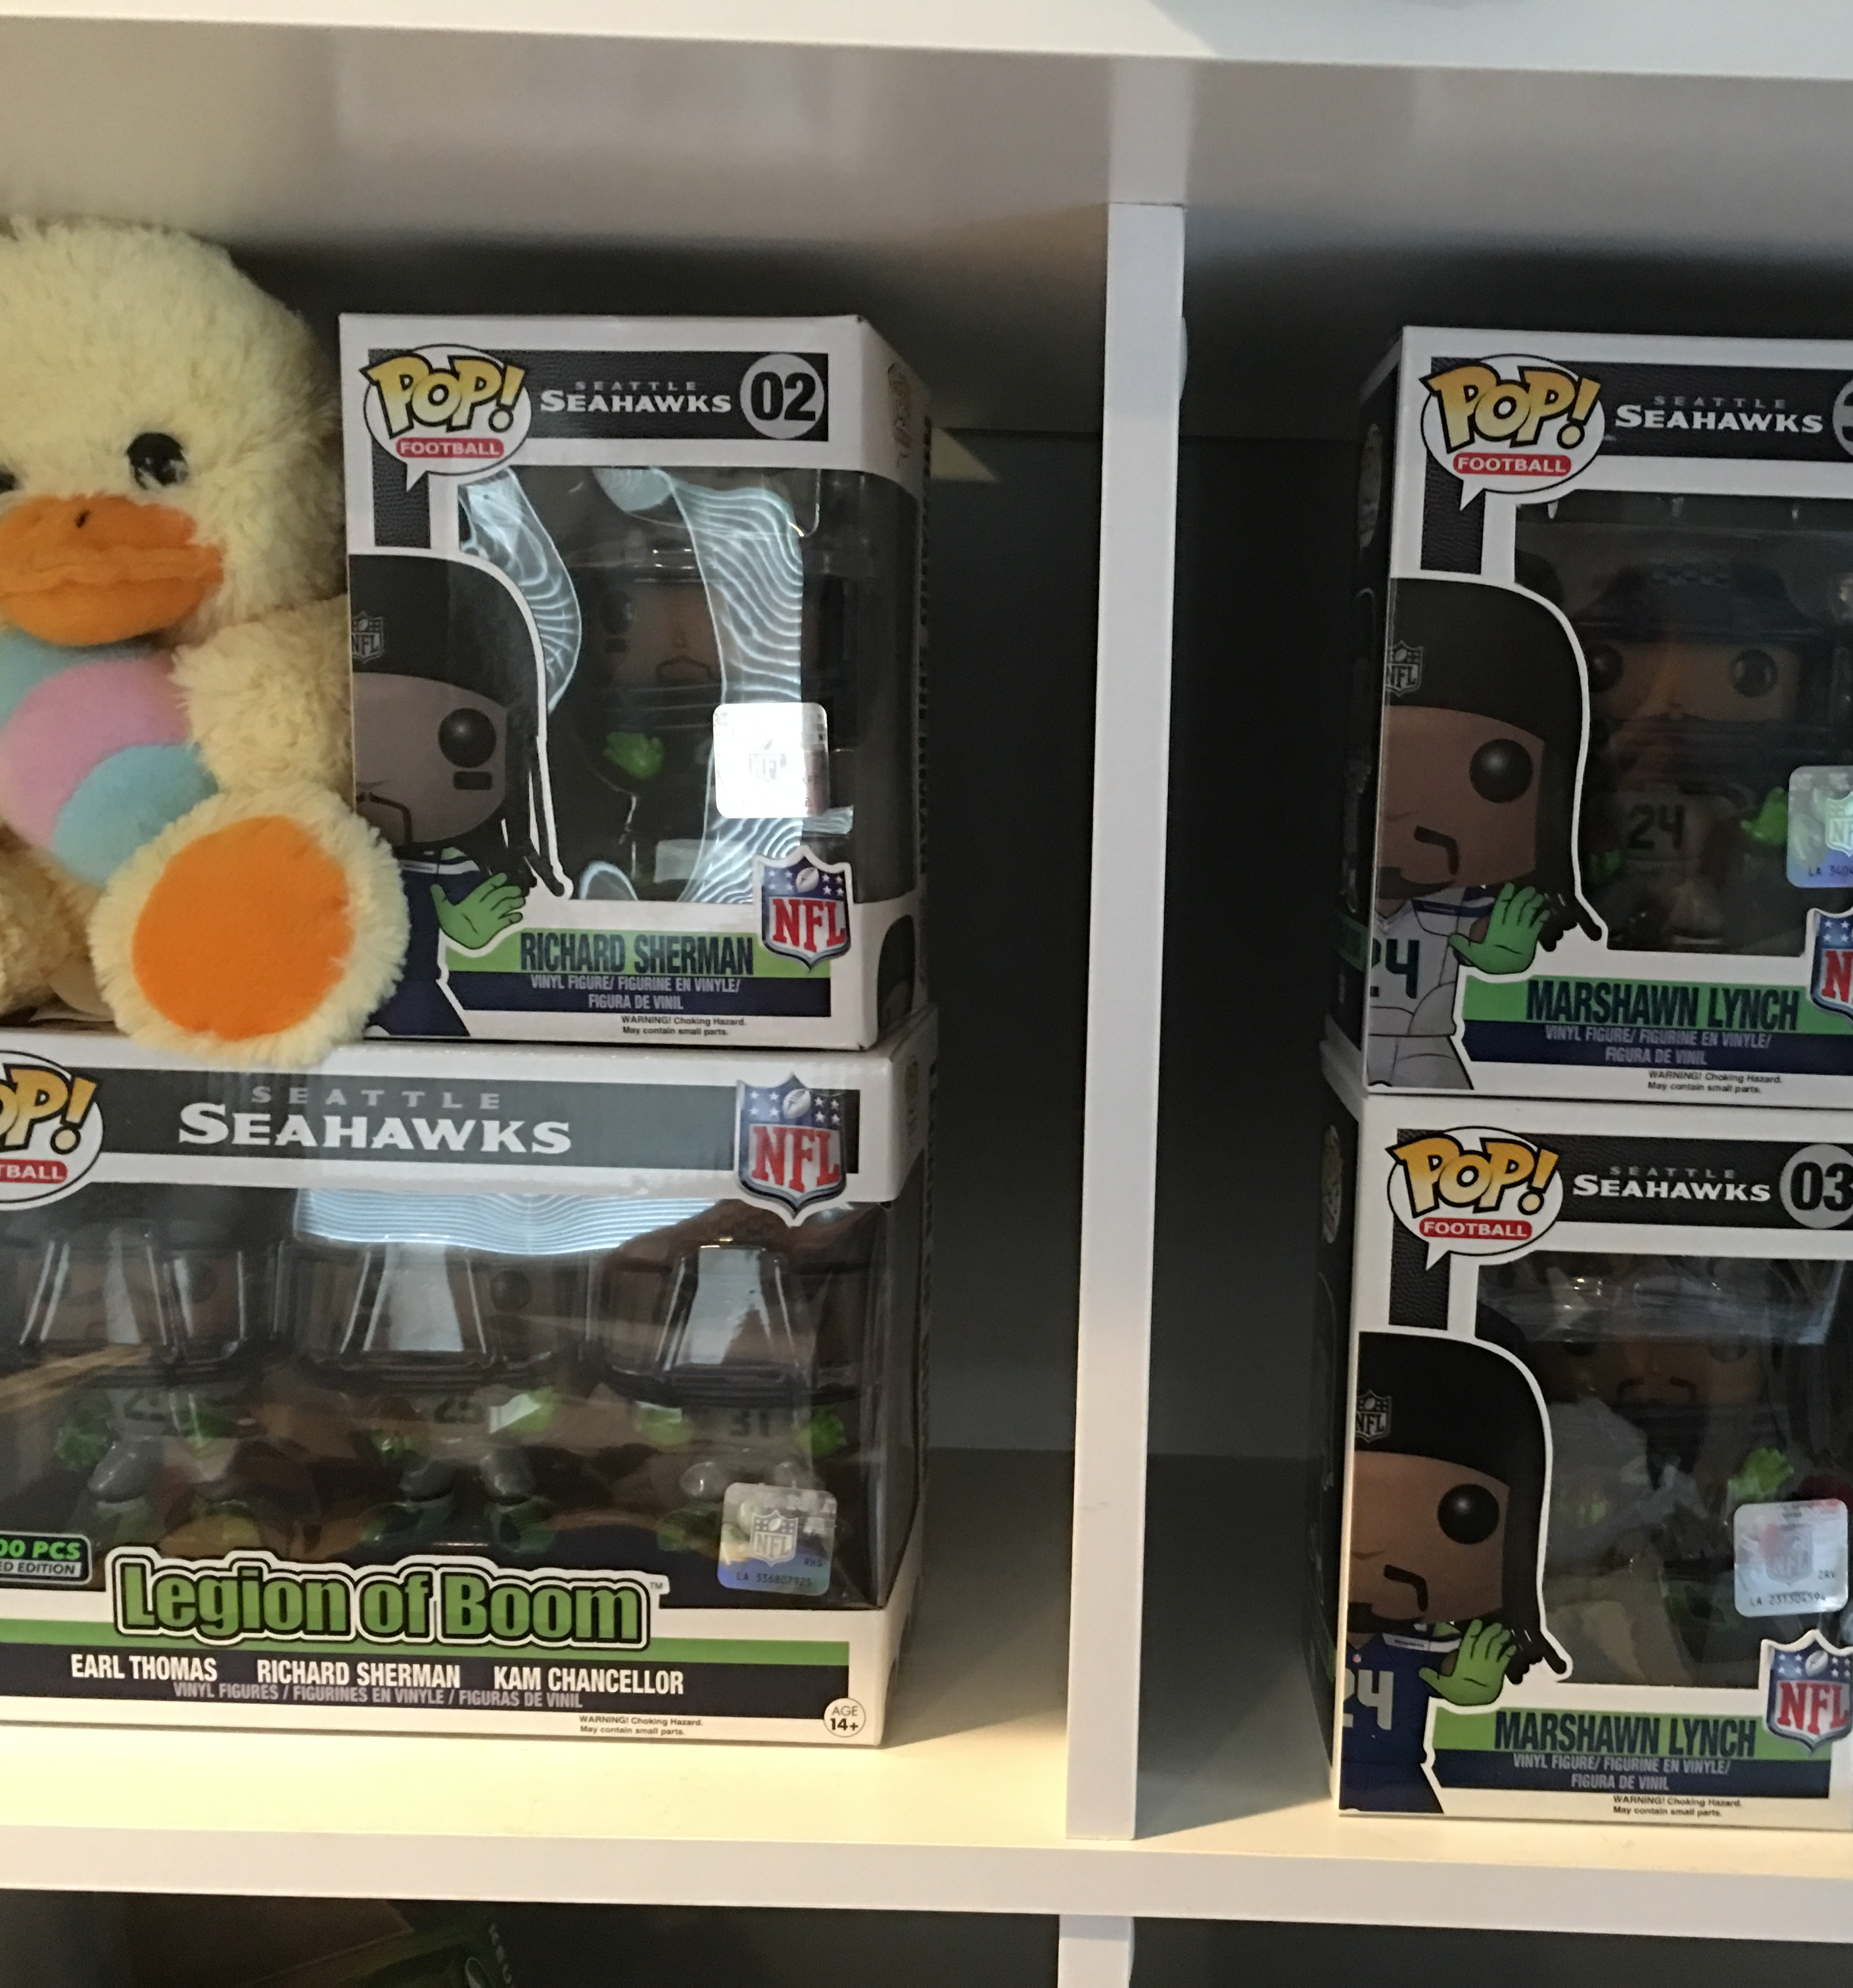
Purpose
Discerning collectors
Storage space
Budget
When to sell?

Slide 6
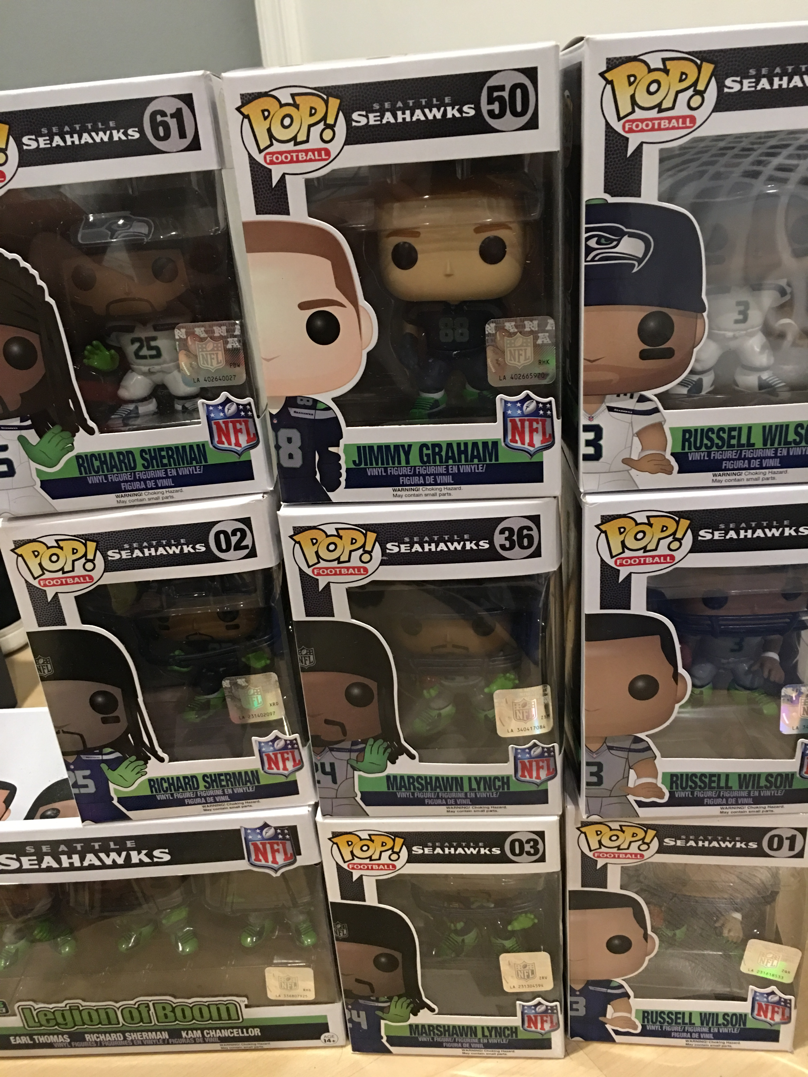
Purpose
Discerning collectors
Storage space
Budget
When to sell?

Slide 7
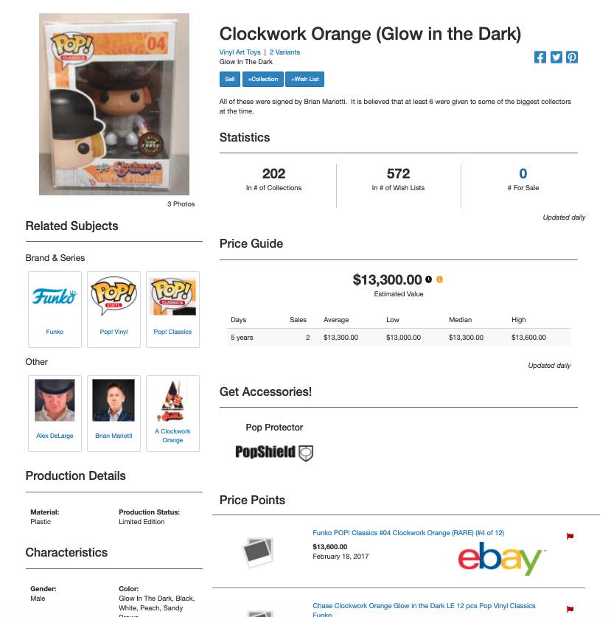
Data Source

Slide 8
Assumptions
Estimated Value
Vaulted
Age
# Produced
Evergreen
Age
Series
TV
Movies
Animation
Games
Pop! Rocks (Musicians)
NFL
Comic-Con
Chase
Freddy Funko
Funko Channel Exclusive
Retailer Exclusive
Glow in the Dark
Glitter
Frocked
Blind Packaging
Bobblehead
Number of Figures in Box
Autographed

Slide 9
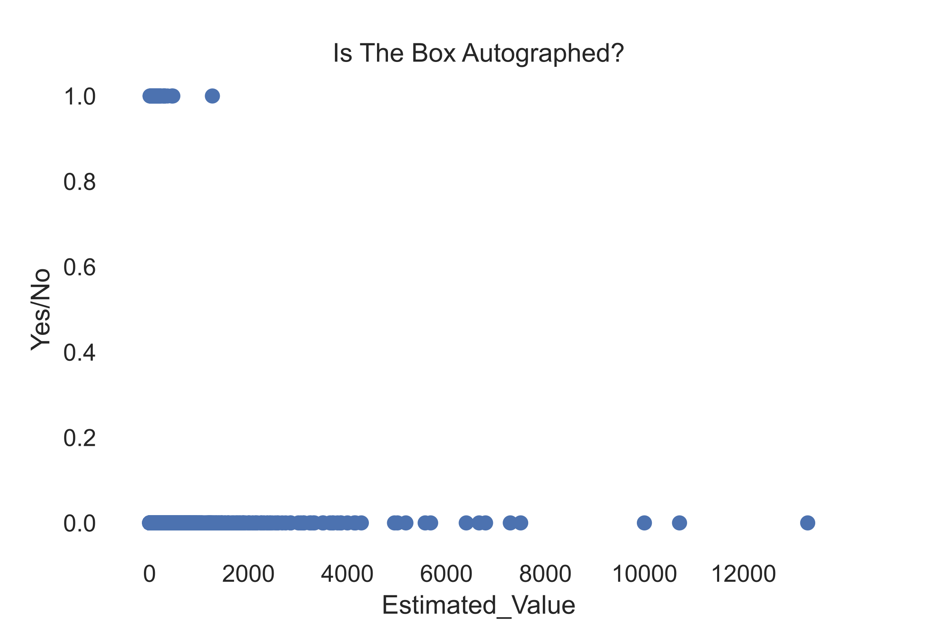
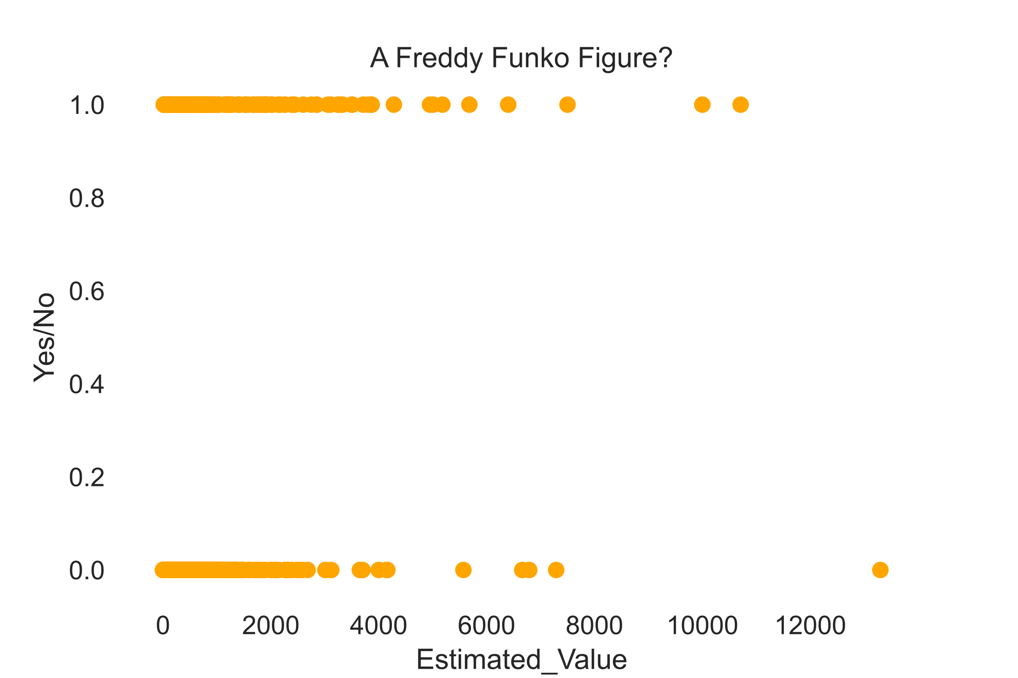

Slide 10
Final Linear Model
Few_Produced: Less than 100
Rarely_Produced: Less than 250
Freddy Funko: Funko Mascot
Limited_Edition: Type of Series/Sticker
Comic_Con: Exclusive to convention
36.72 + 14.94[Few_Produced] + 297.59[Rarely_Produced] + 142 [Freddy_Funko] + 66.78 [Limited Edition] + 37.72 [Comic_Con] + 46.28 [FP*RP] + 346.08 [FP*FF] + 536.67 [LE*FF] + 629.67 [CC*FF] + 14.77[RP*FF] + 484.9 [RP + LE] + 297.38 [RP*CC] + 214.48 [LE*CC]

Slide 11
Final Linear Model
Less than 100: 14.94
Less than 250: 297.59
Freddy Funko: 142
Limited_Edition: 66.78
Comic_Con: 37.72
Less than 100 and 250: 46.28
Less than 100 FF: 346.08
Limited Edition FF: 536.67
Comic-Con FF: 629.67
Less than 250 FF:14.77
Less than 250 LE: 484.9
Less than 250 CC: 297.38
CC Limited Edition: 214.48

Slide 12
Final Linear Model
Less than 100: 14.94
Less than 250: 297.59
Freddy Funko: 142
Limited_Edition: 66.78
Comic_Con: 37.72
Less than 100 and 250: 46.28
Less than 100 FF: 346.08
Limited Edition FF: 536.67
Comic-Con FF: 629.67
Less than 250 FF:14.77
Less than 250 LE: 484.9
Less than 250 CC: 297.38
CC Limited Edition: 214.48

Slide 13
Final Linear Model
Less than 100: 14.94
Less than 250: 297.59
Freddy Funko: 142
Limited_Edition: 66.78
Comic_Con: 37.72
Less than 100 and 250: 46.28
Less than 100 FF: 346.08
Limited Edition FF: 536.67
Comic-Con FF: 629.67
Less than 250 FF:14.77
Less than 250 LE: 484.9
Less than 250 CC: 297.38
CC Limited Edition: 214.48
Test R-squared: 0.2284

Slide 14
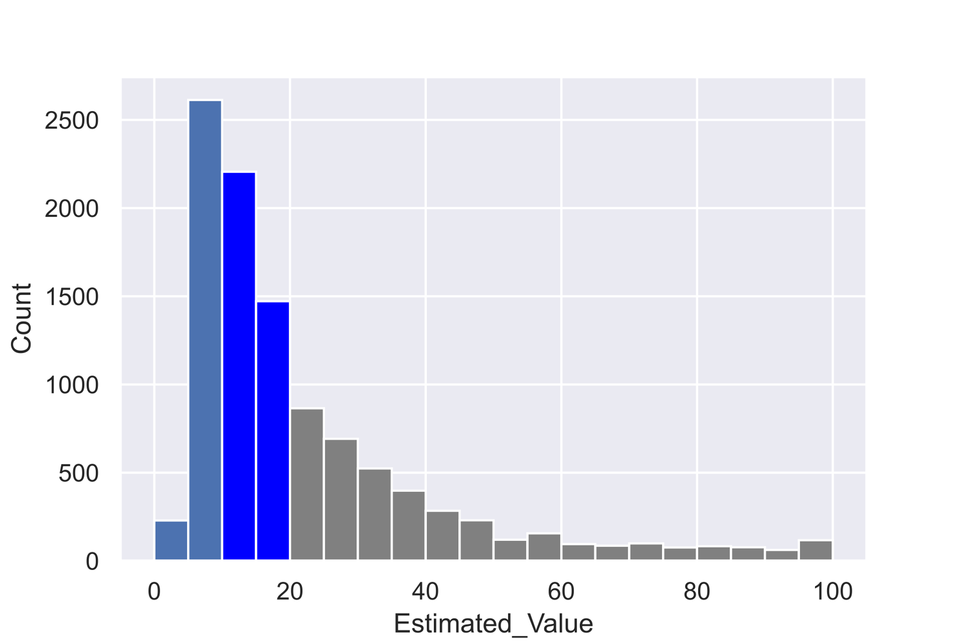
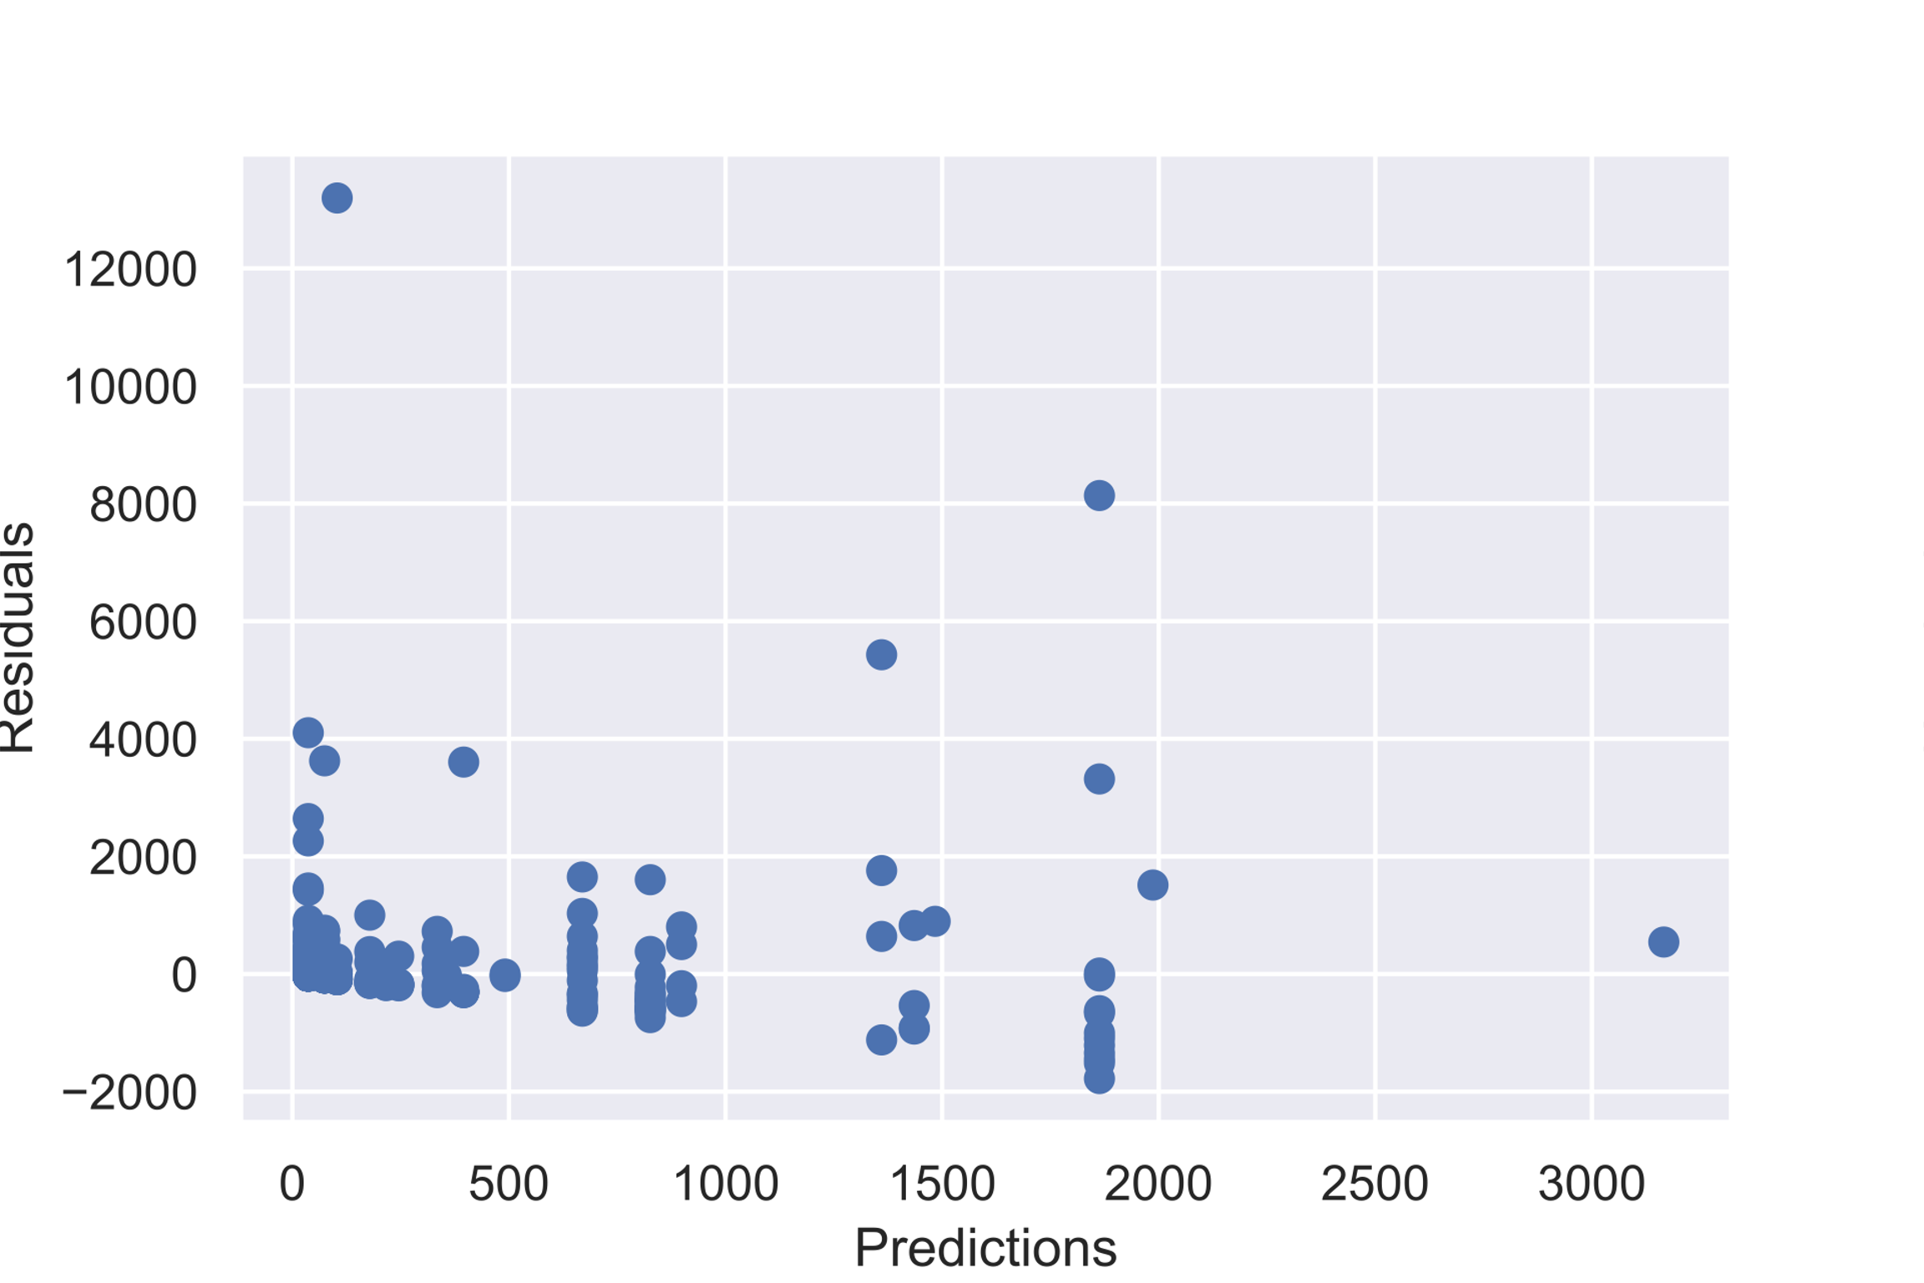
Further Work
Get Vaulted information
Condition and individual price information
2-3 different linear models
Try different model(s)
Drill down
Expand and look at other lines

Slide 15
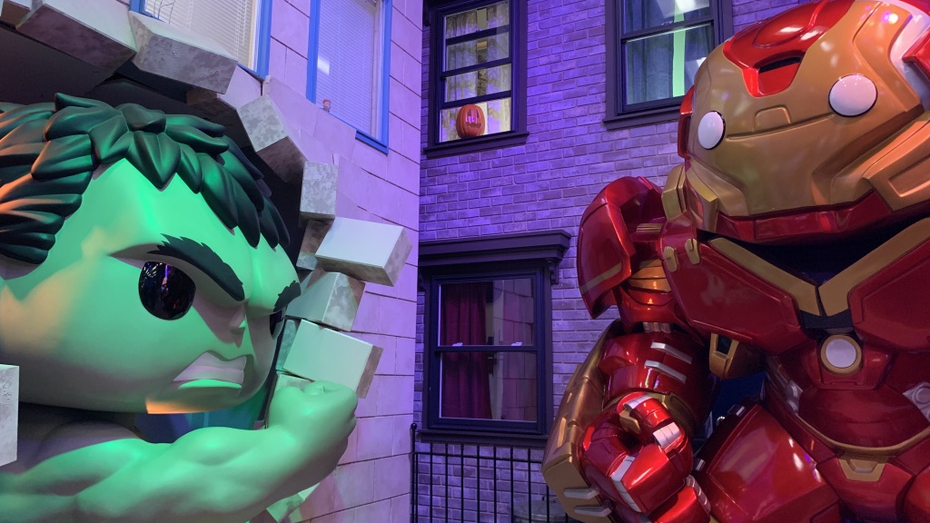
QUESTIONS?

Slide 16
APPENDIX

Slide 17
